Slide 1
SECONDARY LET EXAM COVERAGE FOR GENERAL EDUCATION

Slide 2
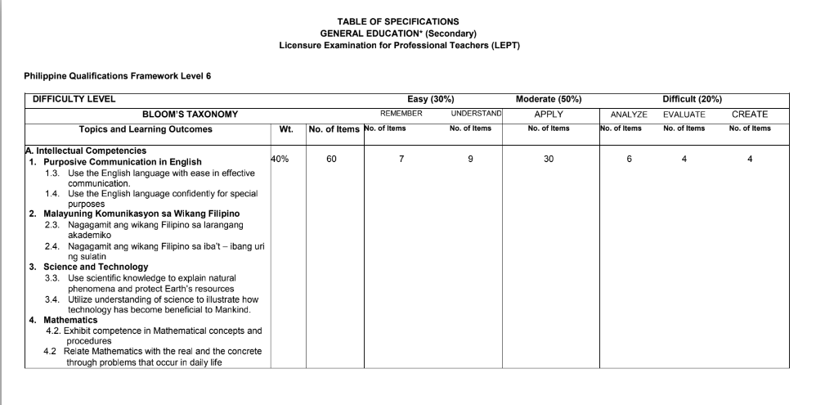

Slide 3
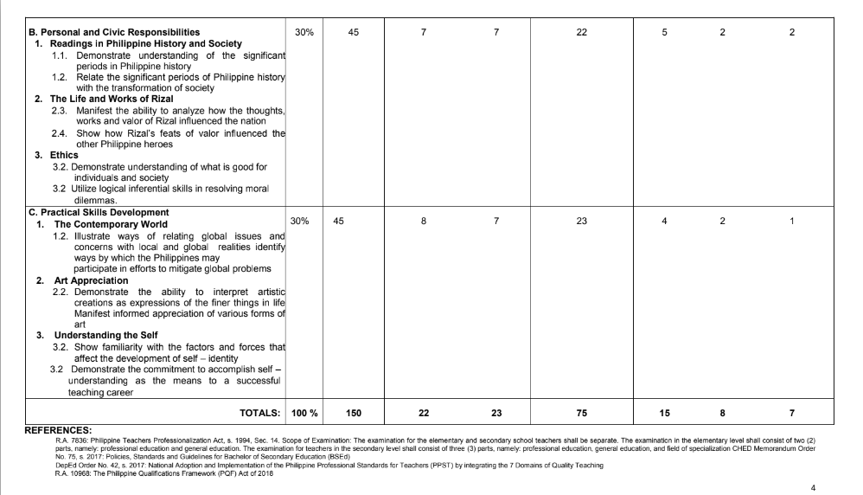

Slide 4
SECONDARY LET EXAM COVERAGE FOR
PROFESSIONAL EDUCATION

Slide 5
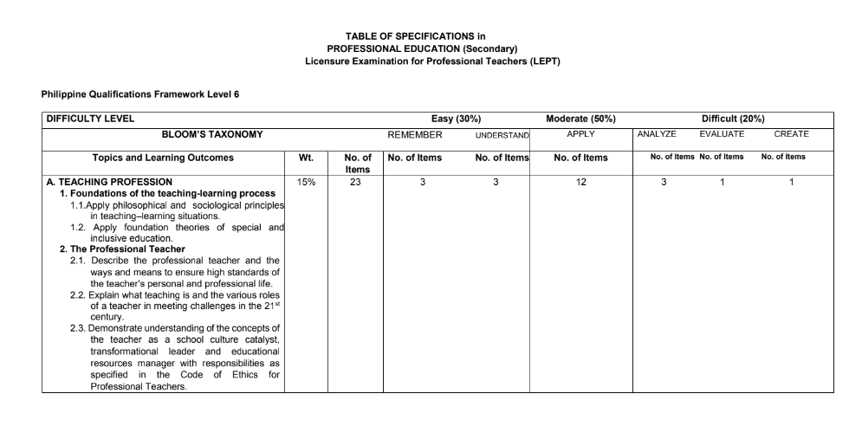

Slide 6
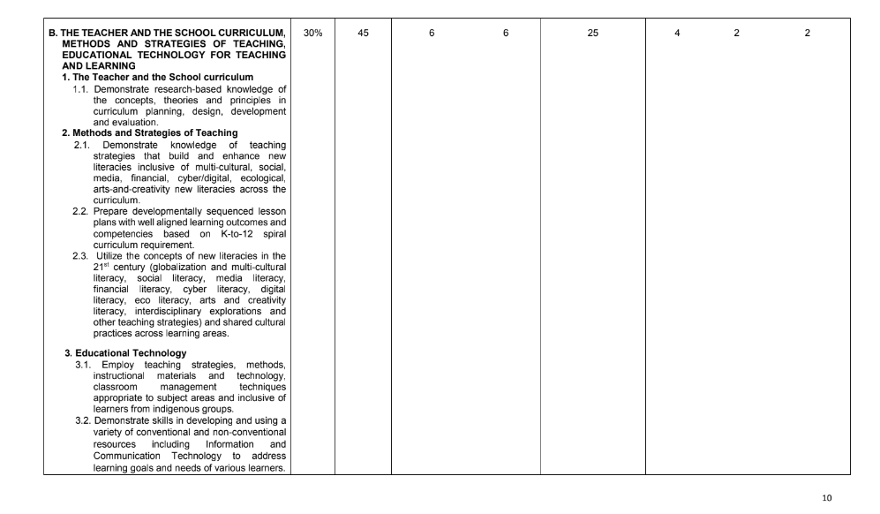

Slide 7
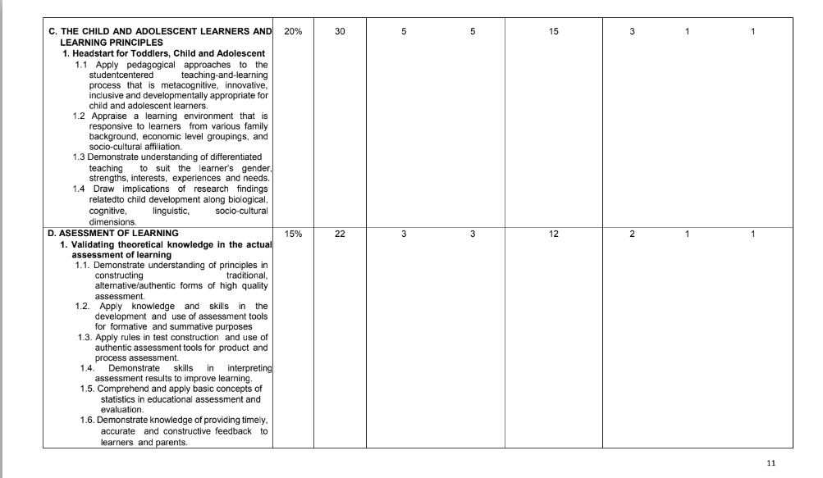

Slide 8
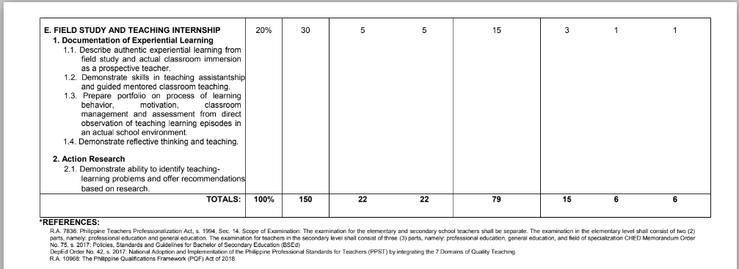

Slide 9
SECONDARY LET EXAM COVERAGE FOR ENGLISH MAJORSHIP

Slide 10
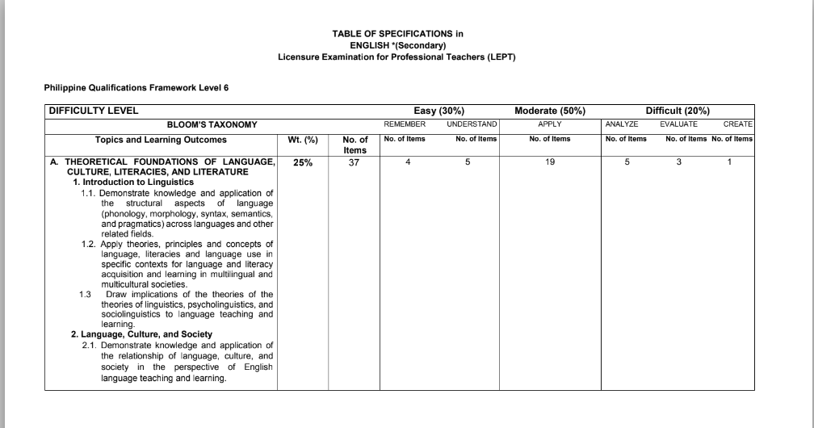

Slide 11
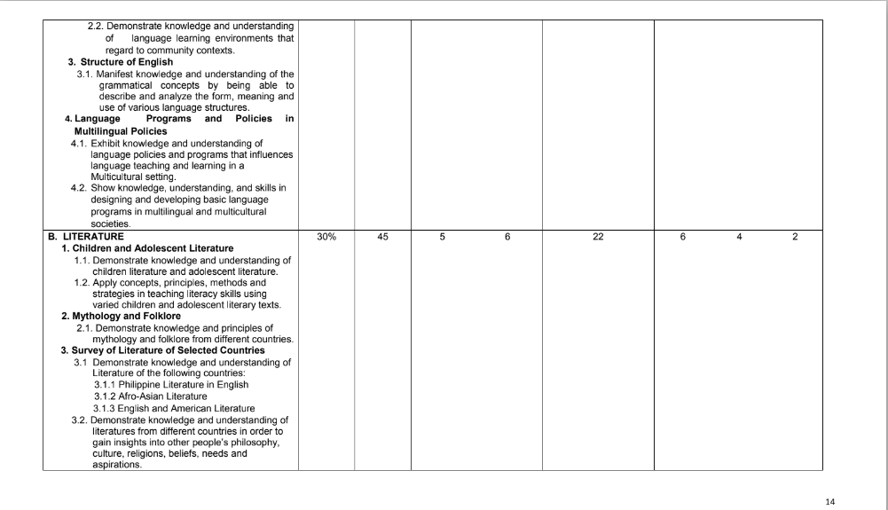

Slide 12
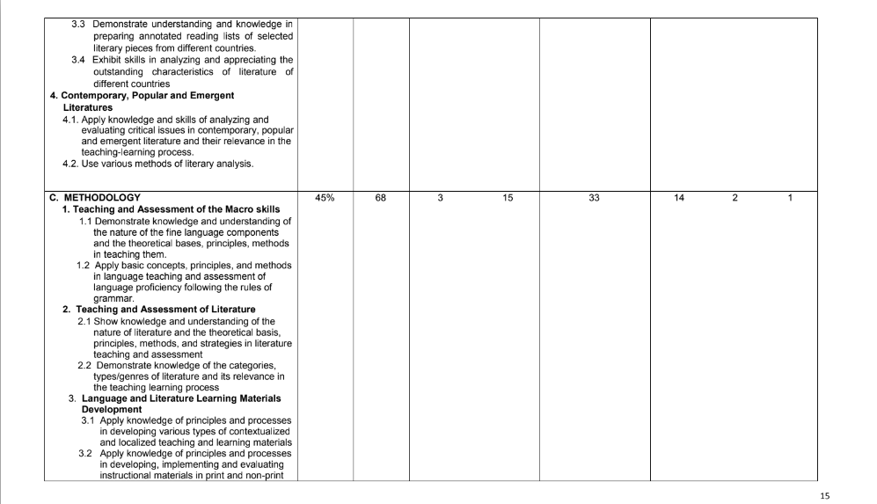

Slide 13
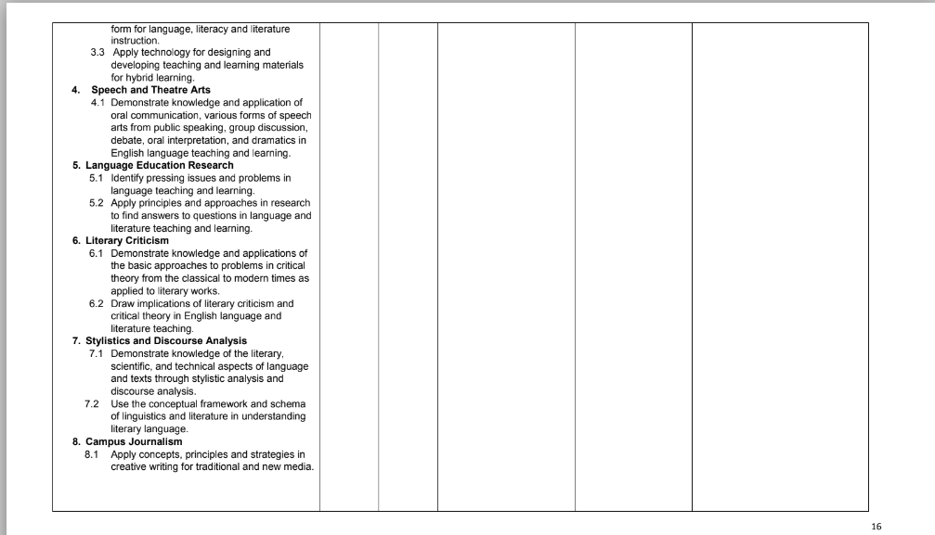

Slide 14
